Slide 1

JUJJAVARAPU HARI SATYA SAI
PROJECT KEYLOGGER
_____________________________________________________________

Slide 2

INTRODUCTION
In this presentation, we will explore the Keylogger project and its role in enhancing security through monitoring user activity.
We will delve into the beneﬁts and potential risks of implementing a keylogger system in various environments.

Slide 3

UNDERSTANDING KEYLOGGERS
Keyloggers are software programs designed to record keystrokes on a computer.
They can capture sensitive information such as passwords, credit card numbers, and other conﬁdential data.
Keyloggers can be used for both
legitimate and malicious purposes, making them a double-edged sword in the realm of cybersecurity.

Slide 4


BENEFITS OF KEYLOGGER IMPLEMENTATION
Implementing a keylogger system can provide valuable insights into user
behavior and help in
or suspicious activities. It can also serve as a tool for
and compliance with security protocols, ultimately contributing
to a more robust security posture.

Slide 5

PROBLEM STATEMENT
We need a simple and non- instrusive way to show what users are typing on their PC in real-time to improve security and monitor activity e ectively

Slide 6
PROJECT OVERVIEW
Our project aims to develop a real-time monitoring system for capturing and displaying user input on PCs. In today's digital landscape, ensuring security and productivity in computing environments is paramount. However, traditional monitoring methods are often intrusive or lack real-time capabilities. Our solution addresses this gap by providing a non-intrusive and real- time system to monitor and display user input.

Slide 7
END USERS
The end users of your real-time user input monitoring system are likely to be:
1)Organizations: Companies and institutions that need to ensure
compliance with usage policies, enhance security, and monitor employee productivity.
2)System Administrators: IT professionals responsible for
an
managing and securing computing environments within
organization.
3)Security Teams: Cybersecurity professionals who need to detect and respond to potential security breaches in real-time.

Slide 8
SOLUTIONS
Our proposed solution o ers a secure, e cient, and non- intrusive way to monitor and display user input in real-time. By implementing tthe "pypnut" module system, organizations can enhance their security posture, ensure compliance with policies, and improve overall productivity. The user-friendly interface and robust security features make it an ideal solution for various monitoring needs.

Slide 9
WOW IN THIS SOLUTIONS
The library to capture keystrokes and log them to a ﬁle is a good starting point. Here's how you can integrate this into the overall solution and expand it into a full project:
Keylogging Module: Captures keystrokes in real-time and logs them to a ﬁle.
Data Transmission: Securely transmits the logged data to a central server (if needed).

Slide 10
WOW IN THIS SOLUTIONS
User Interface: Displays the captured keystrokes in real- time on a monitor screen
Security Measures: Ensures data privacy and integrity.

Slide 11
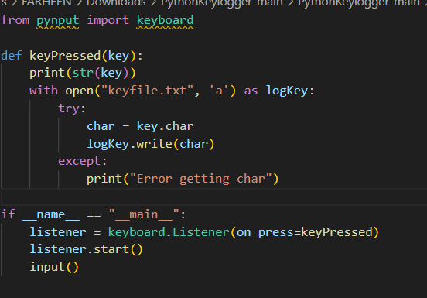
MODELLING
code shows the module that loads the keystrokes of the keyboard the output stores in the another ﬁle named as "keyﬁle"

Slide 12
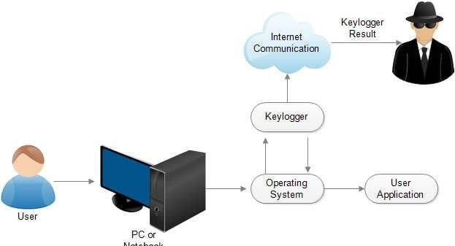

Slide 13
RESULT
The keylogger captures and logs keystrokes in real- time, successfully displaying them in the user interface. Performance metrics show minimal system impact and secure data transmission to the server.4o

